Slide 1


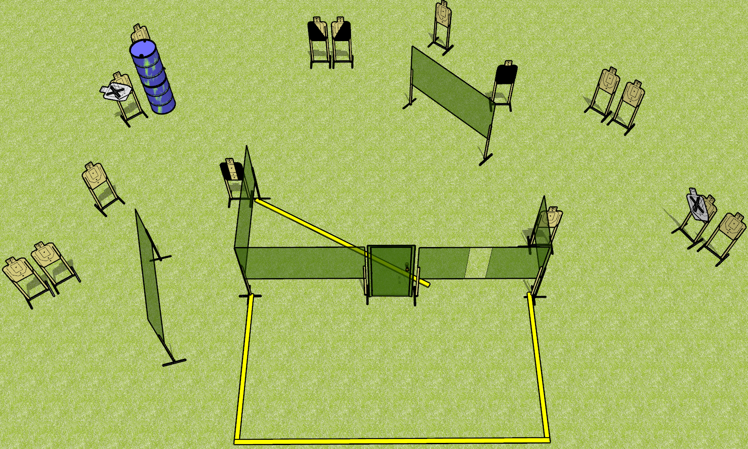
 | Dothan Gun Club – USPSA Match Open Up Course Designer : Drew Coleman
Round Count 30 rounds 15 USPSA targets
Equipment List 10 wall feet 1 tuxedo, 1 headshot, 1 left and 1 right diagonal Notes: Use 10 foot fault lines to extend back. Left NS target needs to be visible from the forward shooting area. Headshot target should only be visible from the window.

Slide 2
Open Up
Written Stage Briefing
Open Up is a 30 round, 150 point, Comstock field course. There are 15 USPSA targets. The best 2 hits on paper will score. The start signal is audible.
Handgun start position is both hands touching door. Handgun is loaded and holstered.
PCC start position is muzzle touching door. Loaded carbine is held with both hands, safety on.
On start signal, engage targets as they become available from within the shooting area.

